Slide 1
DS 100 Discussion 8: Regression & Least Squares
Vikram Sreekanti
03/12/2020

Slide 2
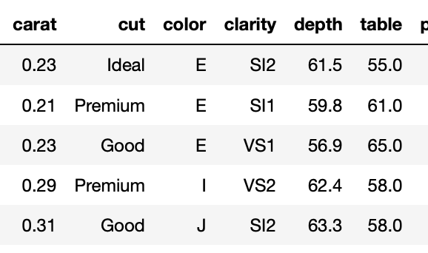
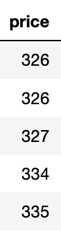
Linear Regression: Overview
Input Data
Output Variable
x θ =
Features

Slide 3

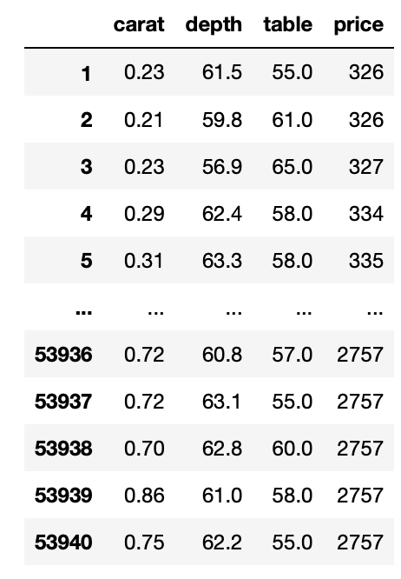
Linear Regression: Overview
[0.23 61.5 55.0]
[θ₁
θ₂
θ₃]
x
=
.23θ₁ + 61.5θ₂ + 55θ₃

Slide 4
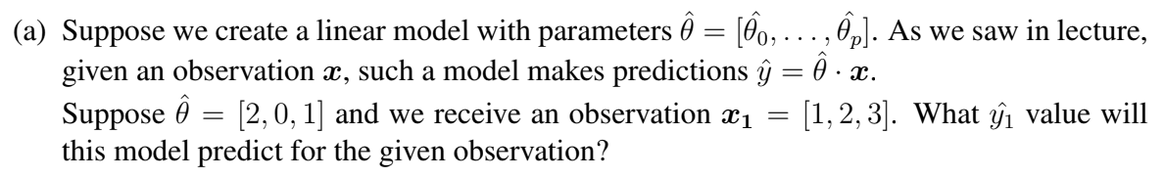
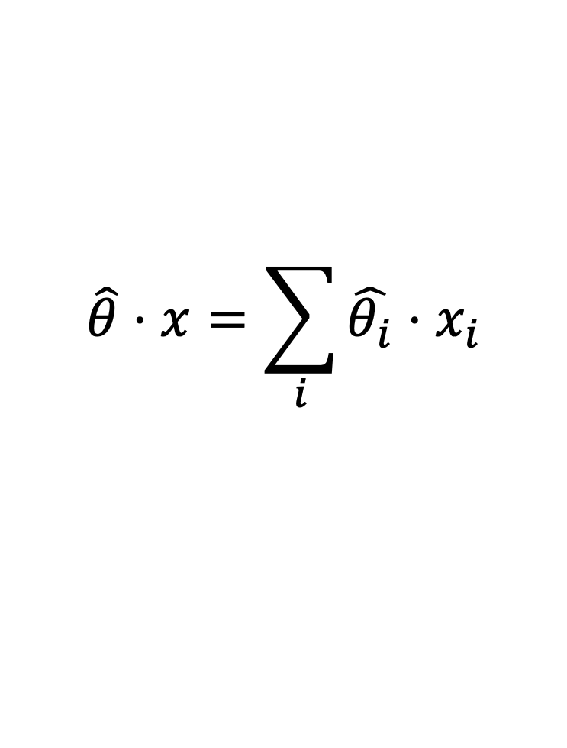
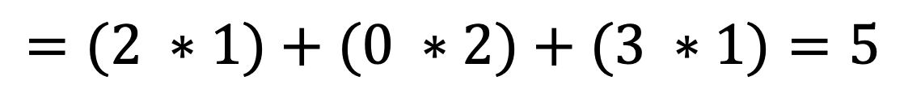
Linear Regression: Exercises
$$\hat{θ}⋅x=\sum_{i}{\hat{θ_{i}}⋅x_{i}}$$
Reminder:
$$=(2 ∗1)+(0 ∗2)+(3 ∗1)=5$$

Slide 5

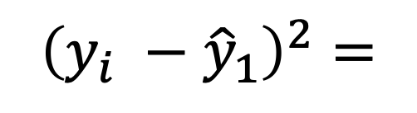
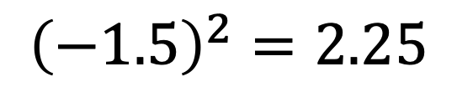
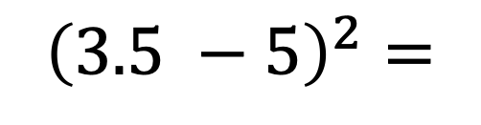
Linear Regression: Exercises
$${\left(y_{i} −{\hat{y}}_{1}\right)}^{2}=$$
$${\left(3.5 −5\right)}^{2}=$$
$${\left(−1.5\right)}^{2}=2.25$$

Slide 6

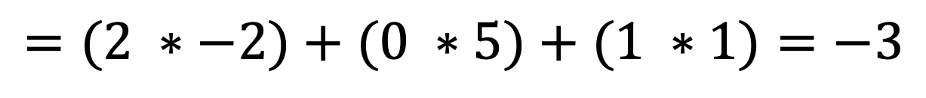
Linear Regression: Exercises
$$\hat{θ}⋅x=\sum_{i}{\hat{θ_{i}}⋅x_{i}}$$
$$=(2 ∗−2)+(0 ∗5)+(1 ∗1)=−3$$

Slide 7

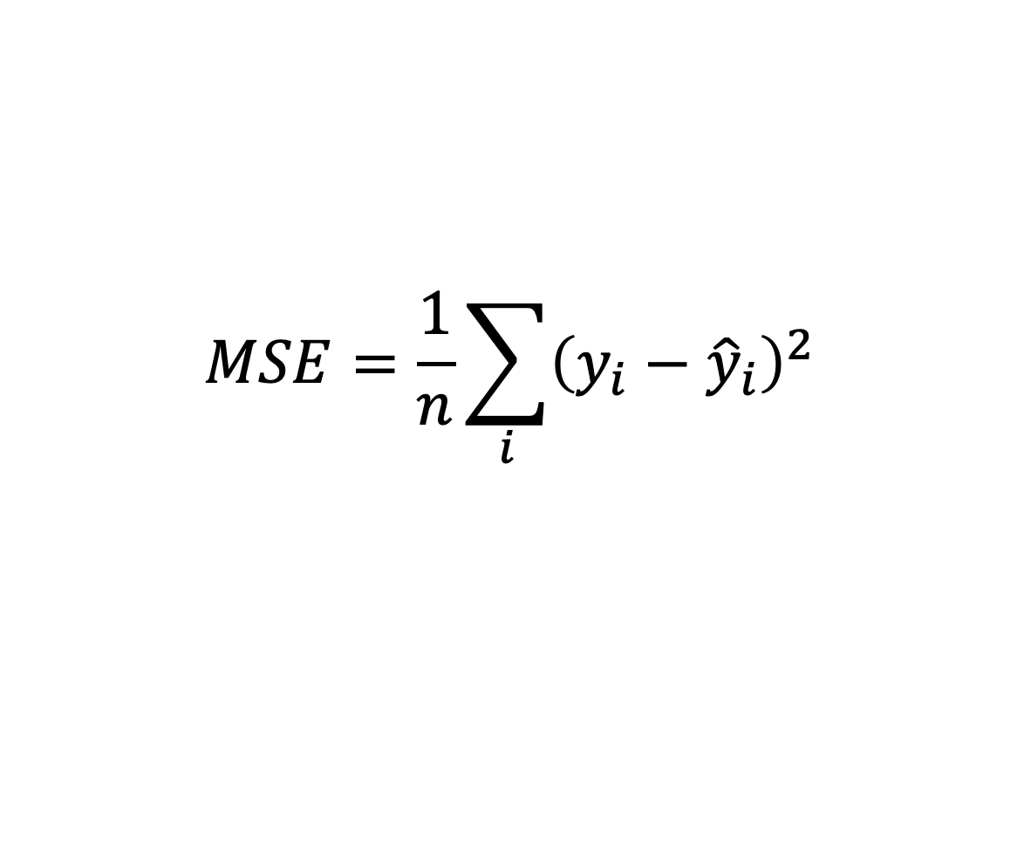

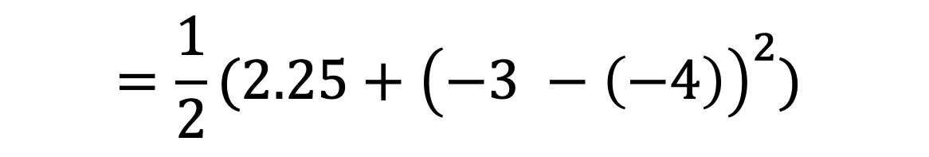
Linear Regression: Exercises
$$MSE=\frac{1}{n}\sum_{i}{{\left(y_{i}−{\hat{y}}_{i}\right)}^{2}}$$
$$=\frac{1}{2}(2.25+{\left(−3 −\left(−4\right)\right)}^{2})$$
$$=\frac{1}{2}\left(2.25+1\right)=1.625$$

Slide 8
Geometry of Least Squares
Intuition:
Our model is a linear combination of the feature matrix (X) using model weights (θ)
Thus, the prediction must be in the subspace spanned by the columns of X
This is a fancy way of saying that you take some linear combination (weighted sum) of the columns of X
You can minimize your error (residual) by taking the projection of Y (true observed value) onto the column space of X

Slide 9
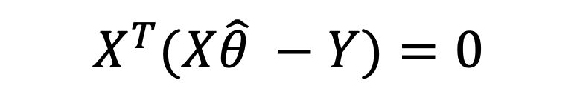

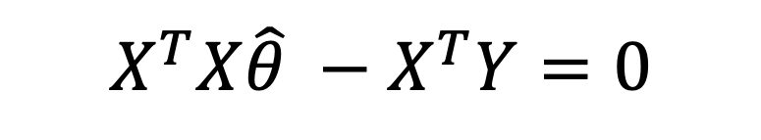
Geometry of Least Squares
Intuition:
You can minimize your error (residual) by taking the projection of Y (true observed value) onto the column space of X
$$X^{T}(X\hat{θ} −Y)=0$$
$$X^{T}X\hat{θ} −X^{T}Y=0$$
$$\hat{θ}={\left(X^{T}X\right)}^{−1}X^{T}Y$$
See lecture for a detailed explanation of the math!

Slide 10
Geometry of Least Squares: Exercises
What is always true about the residuals in least squares regression? Select all that apply.
They are orthogonal to the column space of the design matrix.
They represent the errors of the predictions.
Their sum is equal to the mean squared error.
Their sum is equal to zero.
None of the above.

Slide 11
Geometry of Least Squares: Exercises
What is always true about the residuals in least squares regression? Select all that apply.
They are orthogonal to the column space of the design matrix.
They represent the errors of the predictions.
Their sum is equal to the mean squared error.
Their sum is equal to zero.
None of the above.

Slide 12
Geometry of Least Squares: Exercises
What is true about the predictions made by OLS? Select all that apply.
They are projections of the observations onto the column space of the design matrix.
They are linear in the chosen features.
There are orthogonal to the residuals.
Their are orthogonal to the column space of the features.
None of the above.

Slide 13
Geometry of Least Squares: Exercises
What is true about the predictions made by OLS? Select all that apply.
They are projections of the observations onto the column space of the design matrix.
They are linear in the chosen features.
There are orthogonal to the residuals.
Their are orthogonal to the column space of the features.
None of the above.

Slide 14

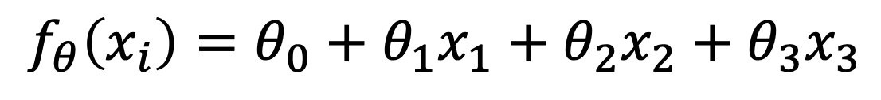
Modeling: Review
We wish to model exam grades for DS100 students. We collect various information about student habits, such as how many hours they studied, how many hours they slept before the exam, and how many lectures they attended and observe how well they did on the exam. Propose a model to predict exam grades and a loss function to measure the performance of your model on a single student.
$$f_{θ}\left(x_{i}\right)=θ_{0}+θ_{1}x_{1}+θ_{2}x_{2}+θ_{3}x_{3}$$
$$L(f_{θ},x_{i}, y_{i}={\left(f_{θ}\left(x_{i}\right)−y_{i}\right)}^{2}$$

Slide 15
Modeling: Review
Suppose we collected even more information about each student, such as their eye color, height, and favorite food. Do you think adding these variables as features would improve our model?
These features almost definitely won’t improve your model. There will not be any correlation between eye color, height, favorite food, etc. and exam performance. Adding extra “noise” will if anything make the model worse.

